Slide 1

GAME: Listen the dates and write

Slide 2
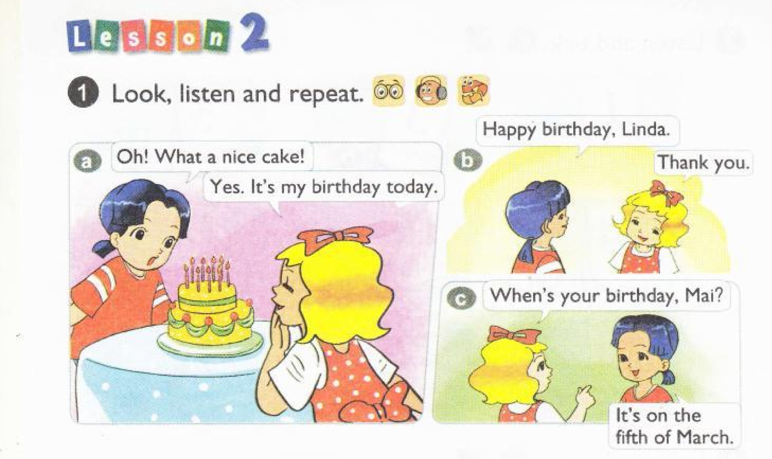


Slide 3
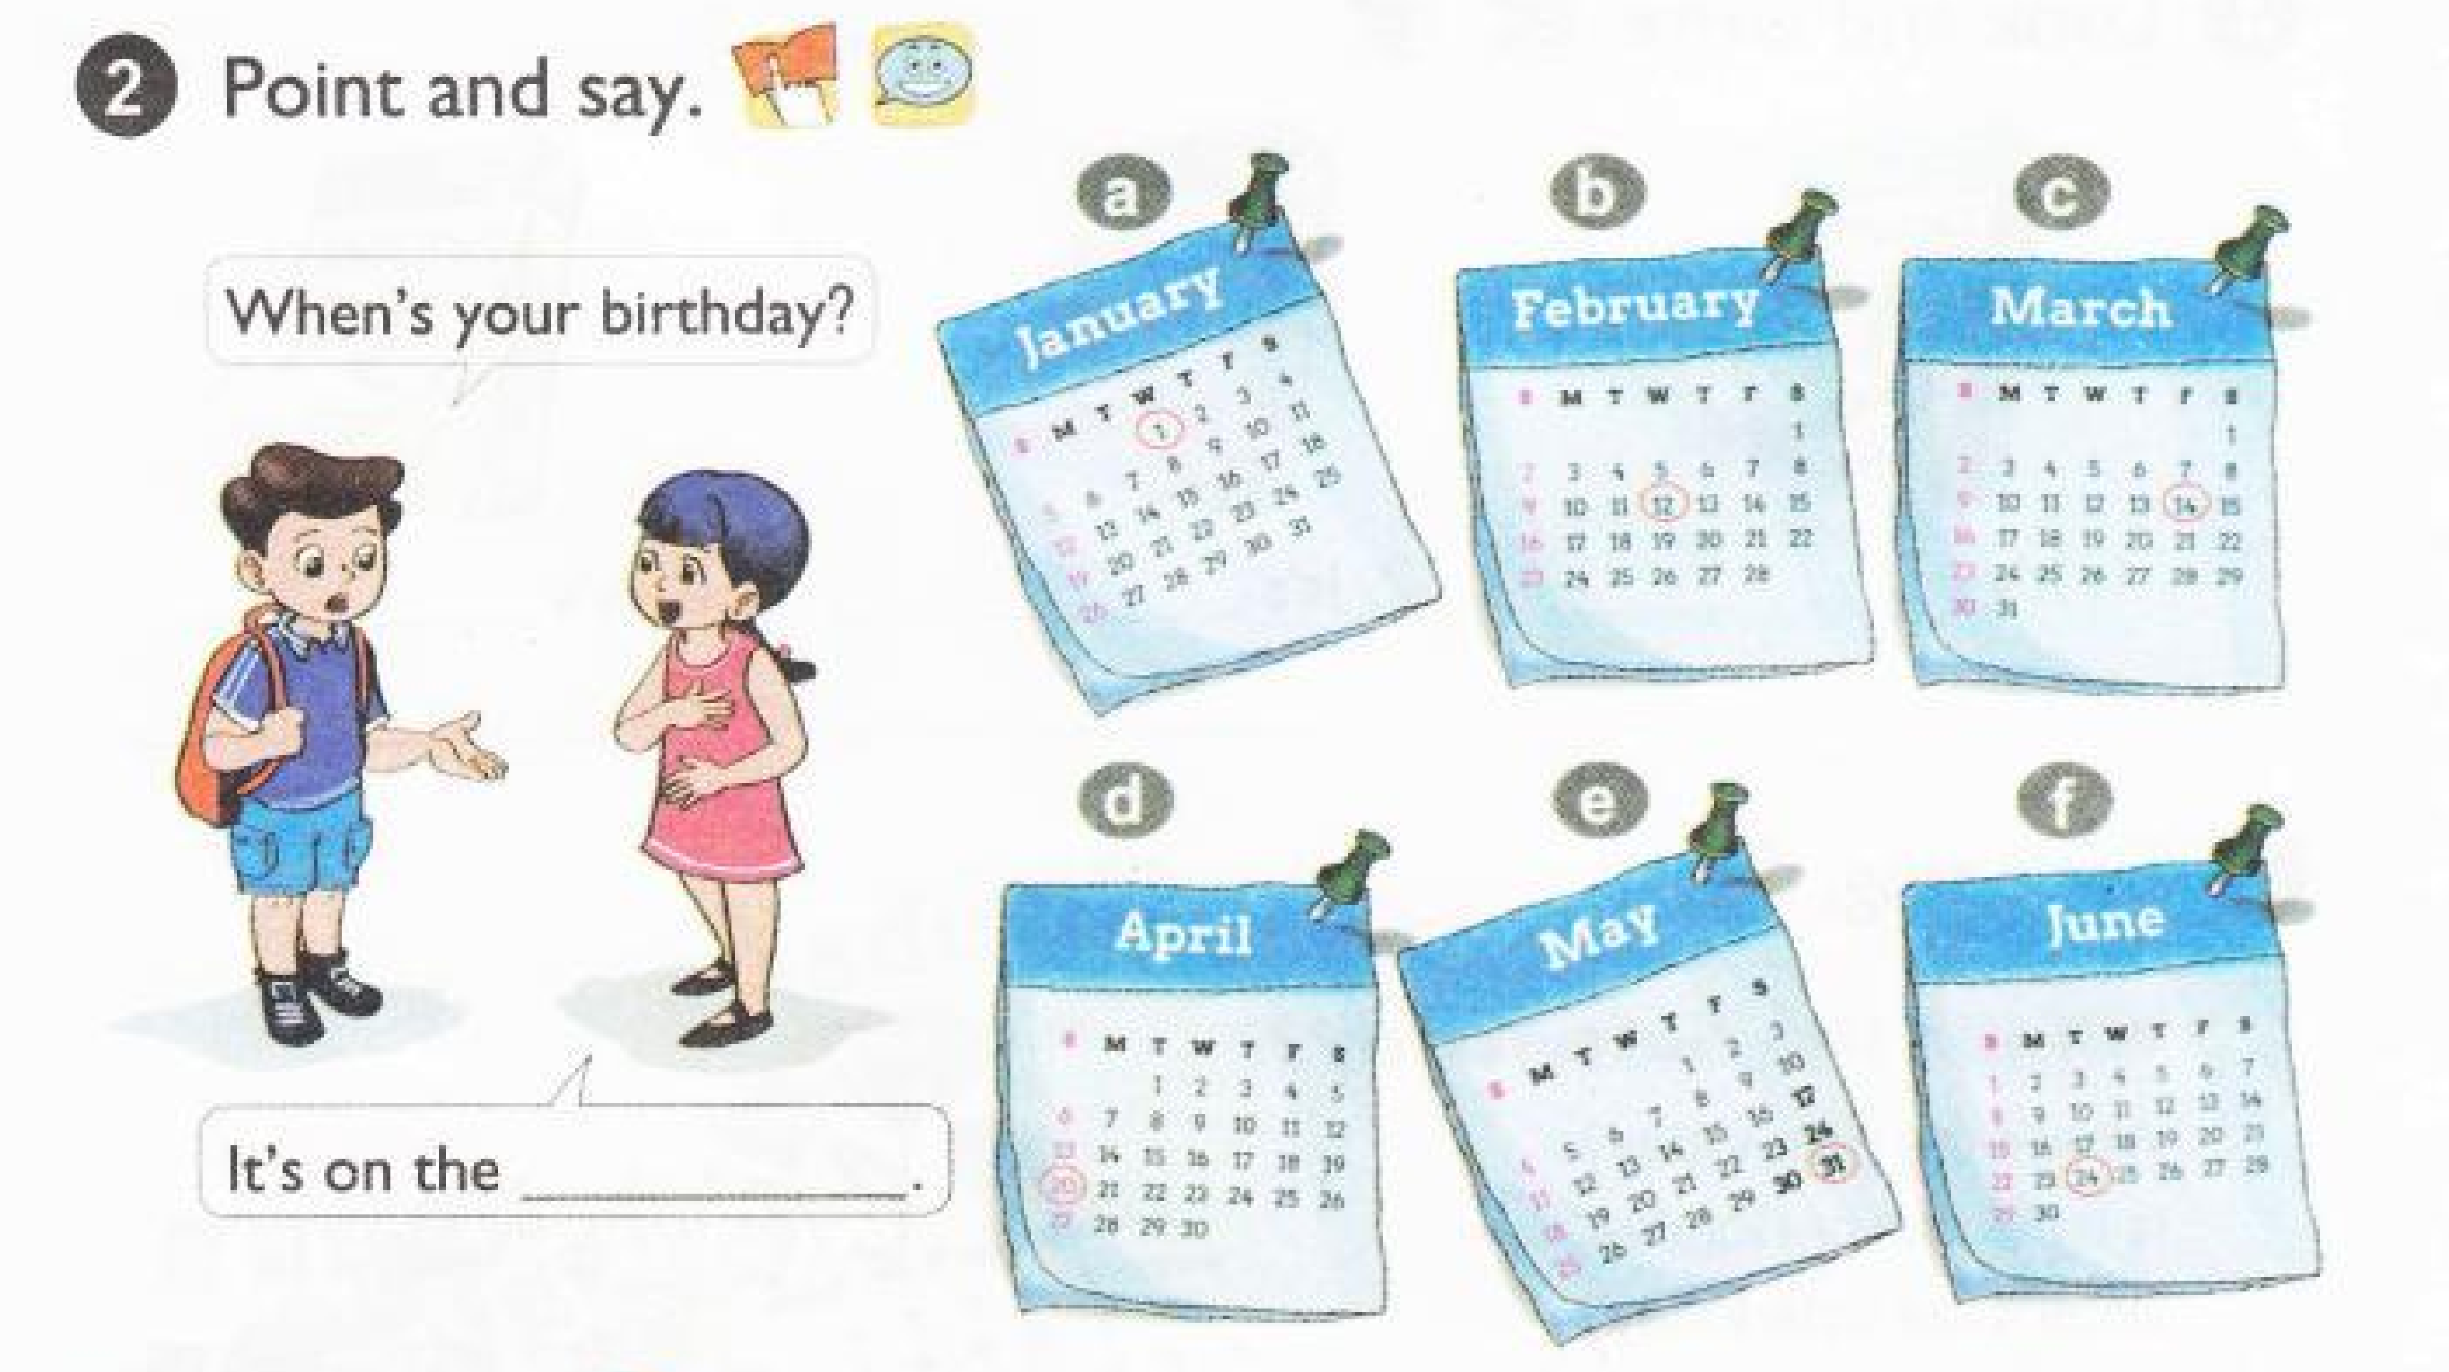

Slide 4
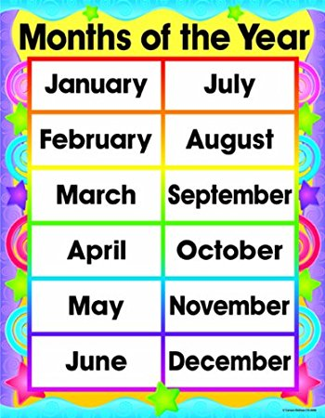

Slide 5
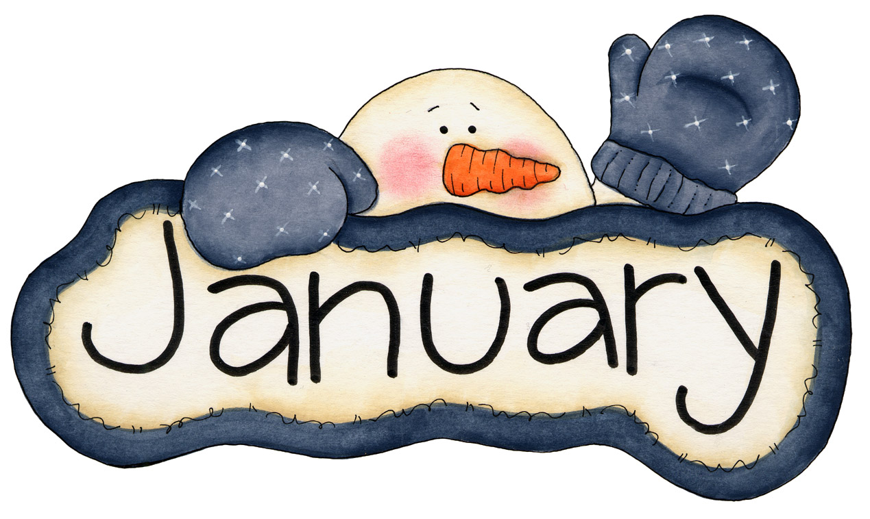
January/ˈdʒæn.jʊ ə .ri/

Slide 6

February /ˈfeb.ru. ə r.i/

Slide 7
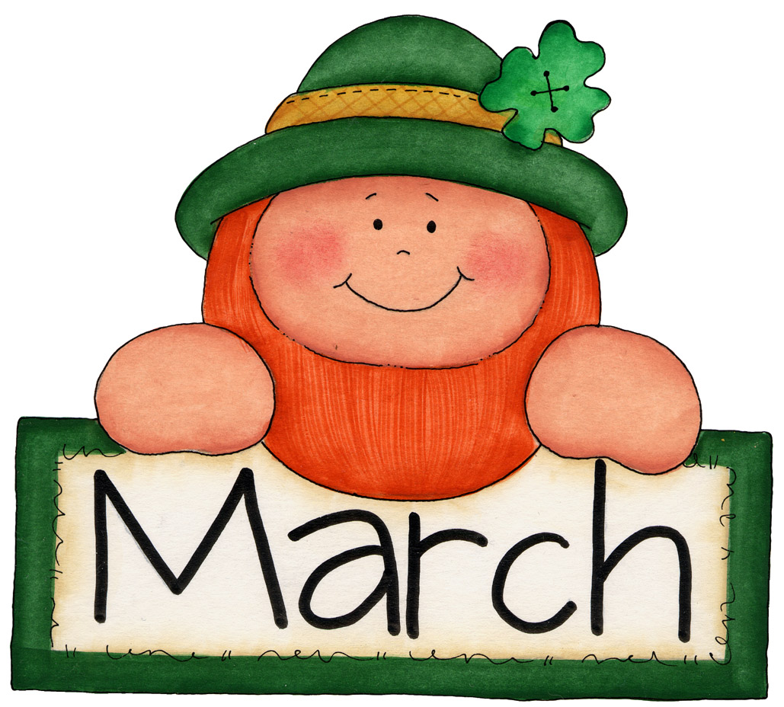
March /mɑːtʃ/

Slide 8

April /ˈeɪ.prəl/

Slide 9

May /meɪ/

Slide 10

June /dʒuːn/

Slide 11

July /dʒʊˈlaɪ/

Slide 12

August /ˈɔː.gəst/

Slide 13

September /sepˈtem.bə r /

Slide 14
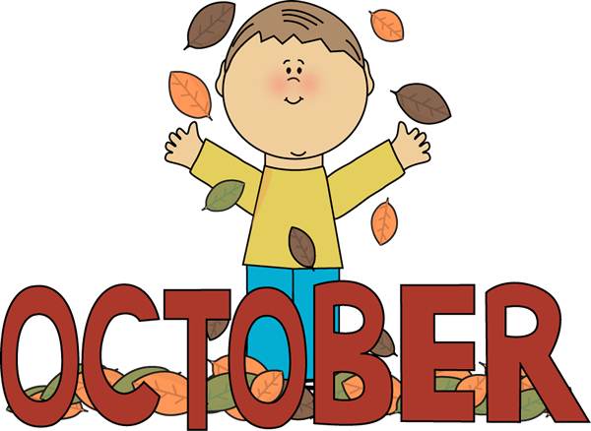
October /ɒkˈtəʊ.bə r /

Slide 15
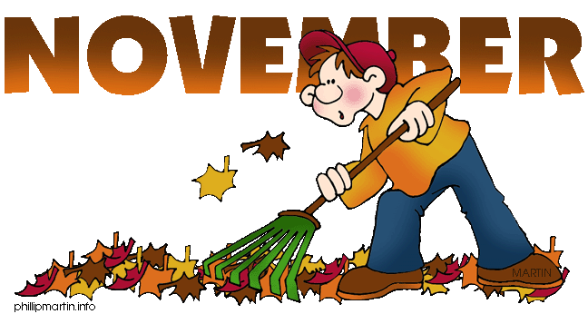
November /nə ʊ ˈvem.bə r /

Slide 16
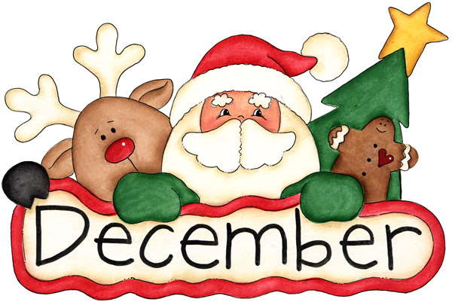
December /dɪˈsem.bə r /

Slide 18

When’s your birthday?
It’s on the twenty eighth of April.

Slide 19
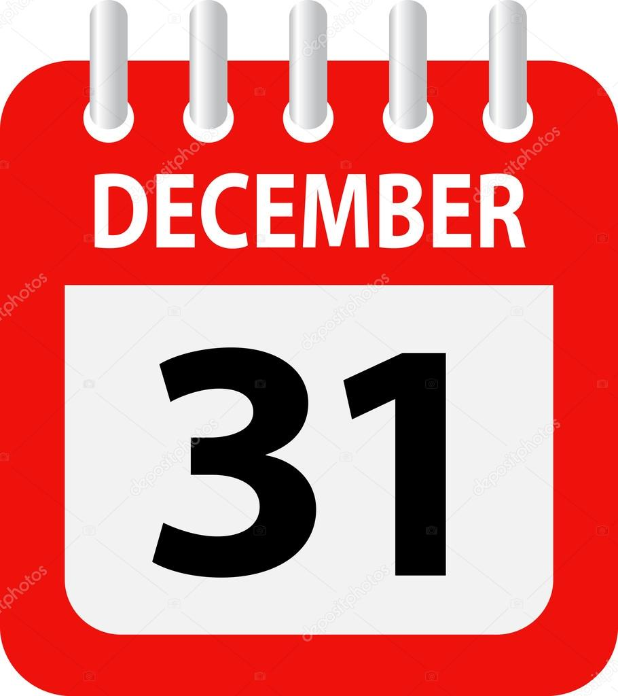
When’s your birthday?
It’s on the thirty first of December.

Slide 20
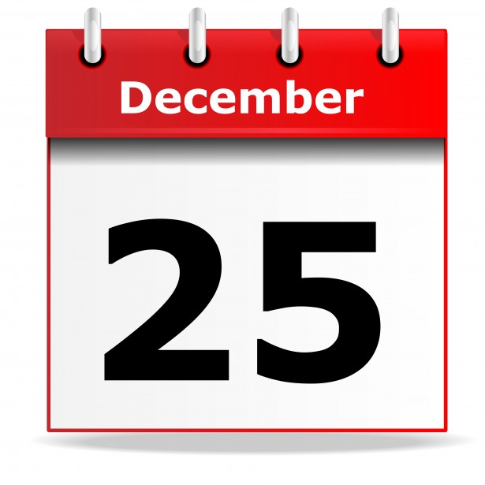
When’s your birthday?
It’s on the twenty fifth of December.

Slide 21

When’s your birthday?
It’s on the fourteenth
of February.

Slide 22

When’s your birthday?
It’s on the sixteenth
of November.

Slide 23

When’s your birthday?
It’s on the sixth
of May.

Slide 24
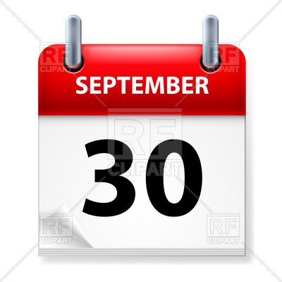
When’s your birthday?
It’s on the thirtieth
of September.

Slide 25
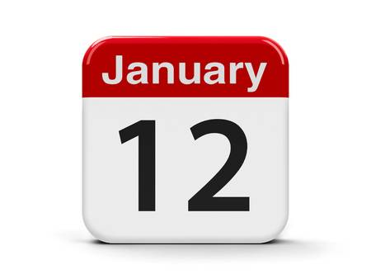
When’s your birthday?
It’s on the twelfth
of January.

Slide 26

When’s your birthday?
It’s on the eighth
of March.

Slide 27
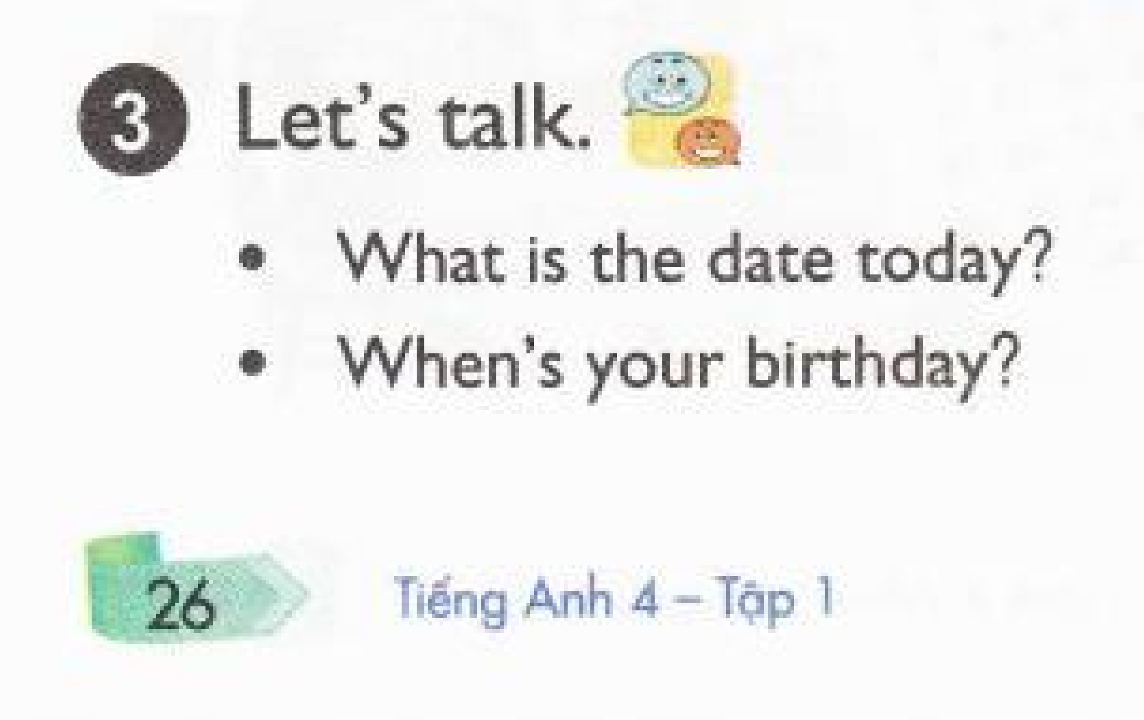

Slide 28
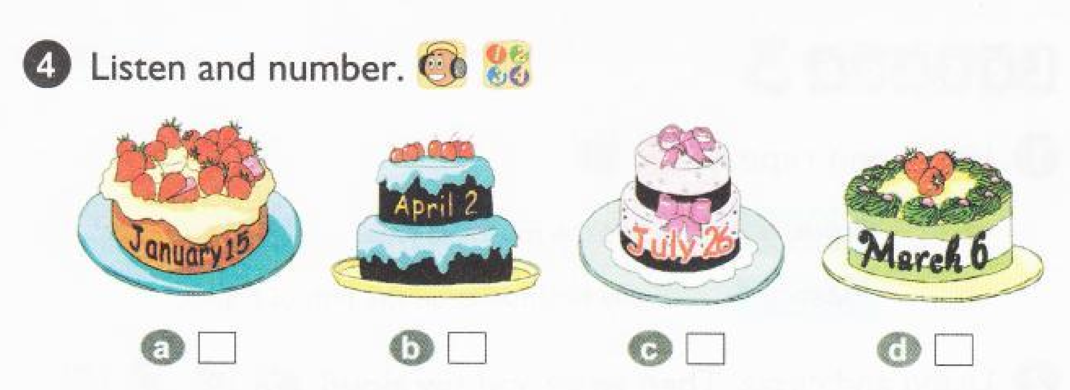


Slide 29
3
1
4
2

Slide 30
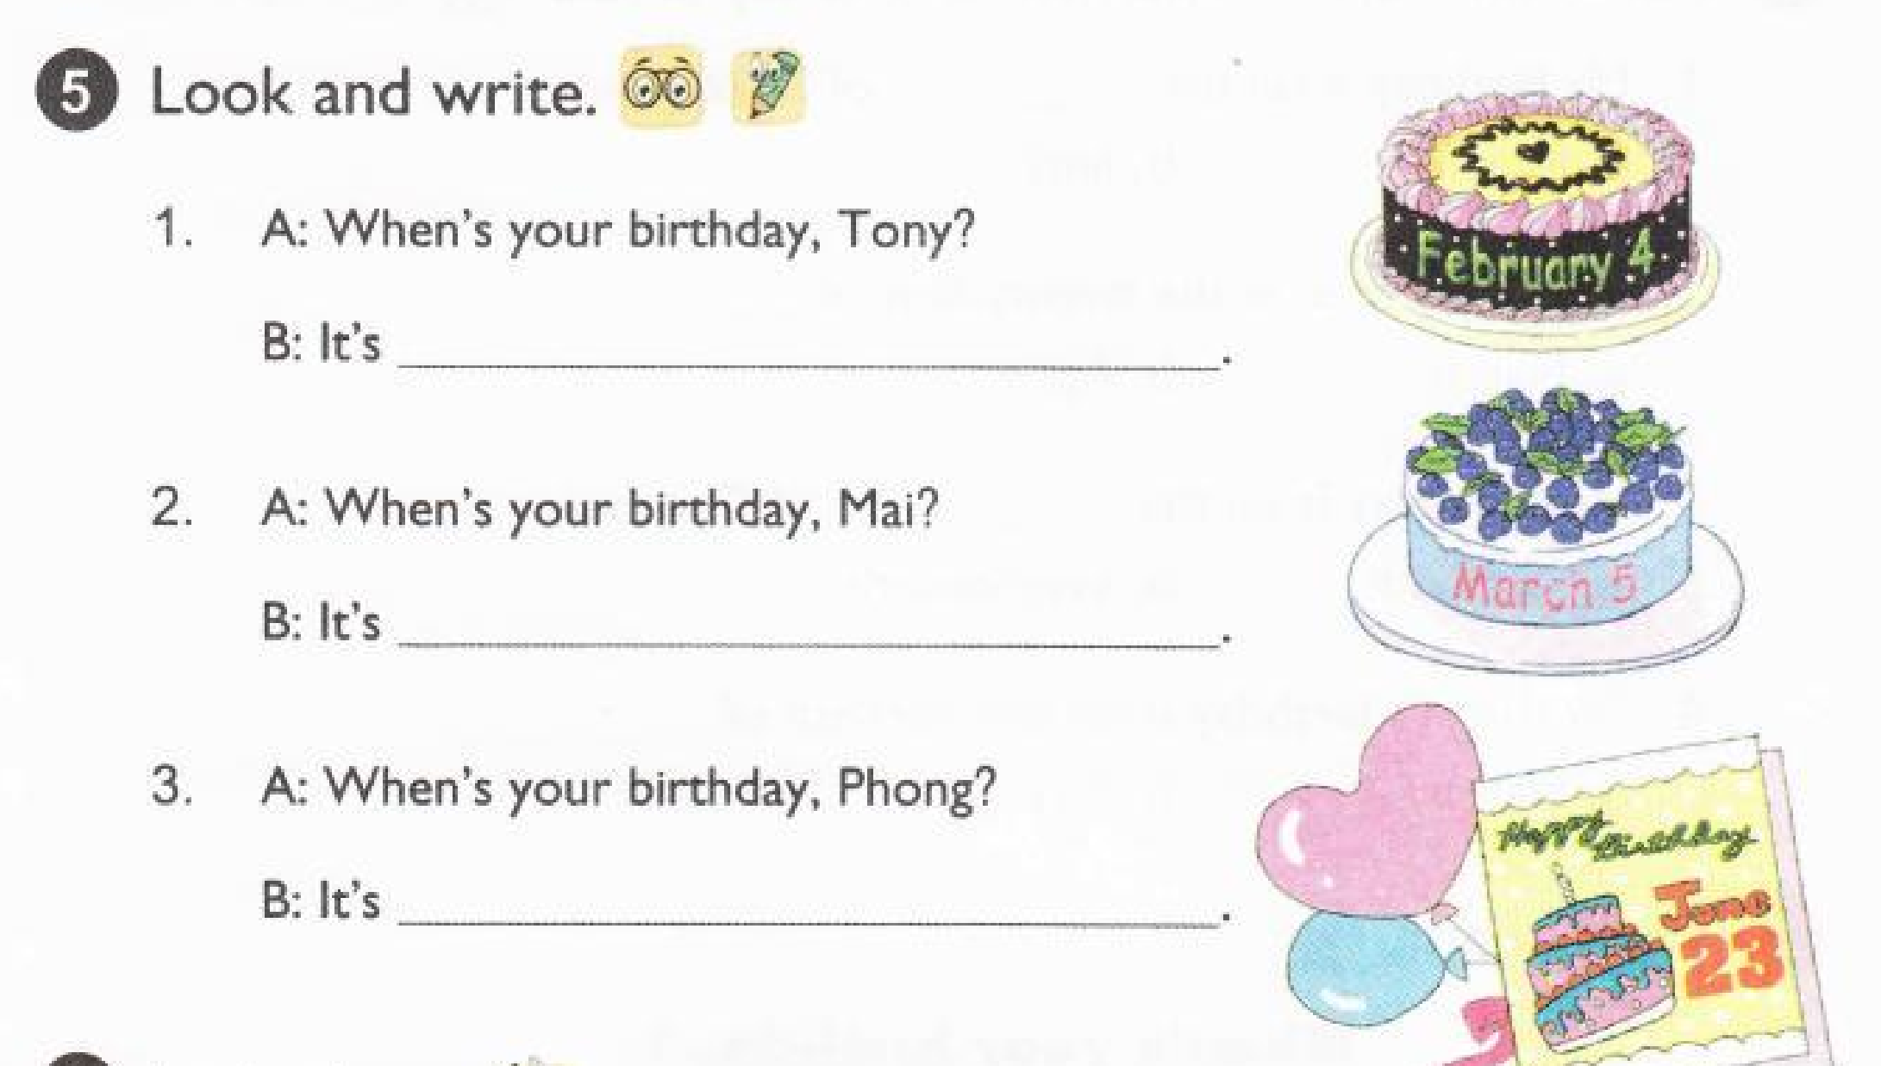
on the fouth of February.
on the fifth of March.
on the twenty third of June.

Slide 31
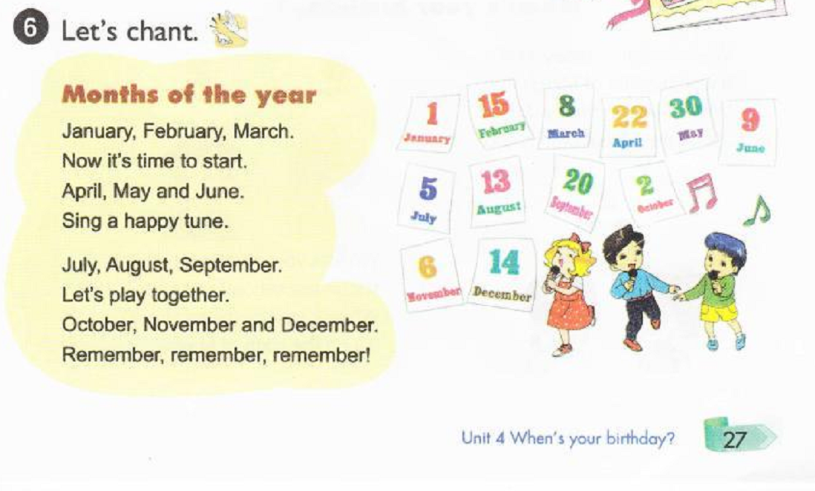

Slide 32
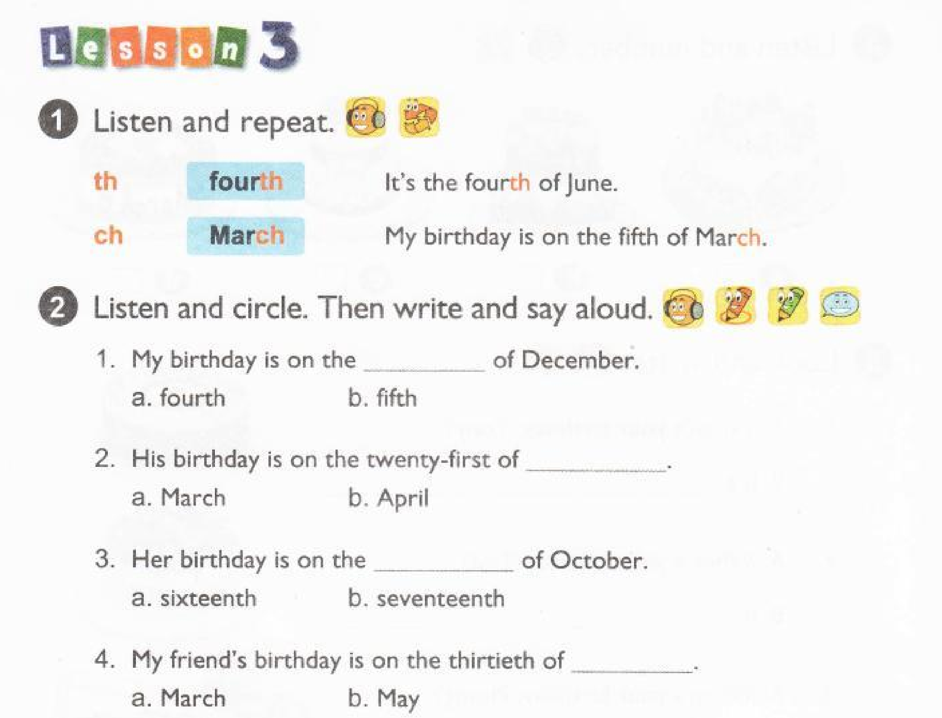


Slide 34
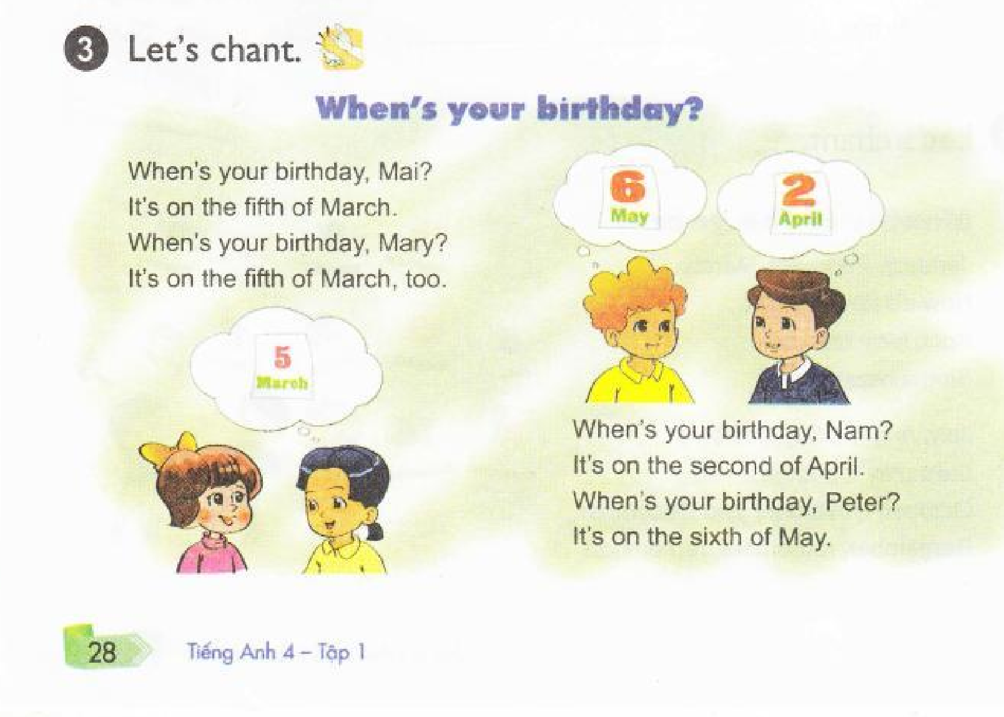

Slide 35
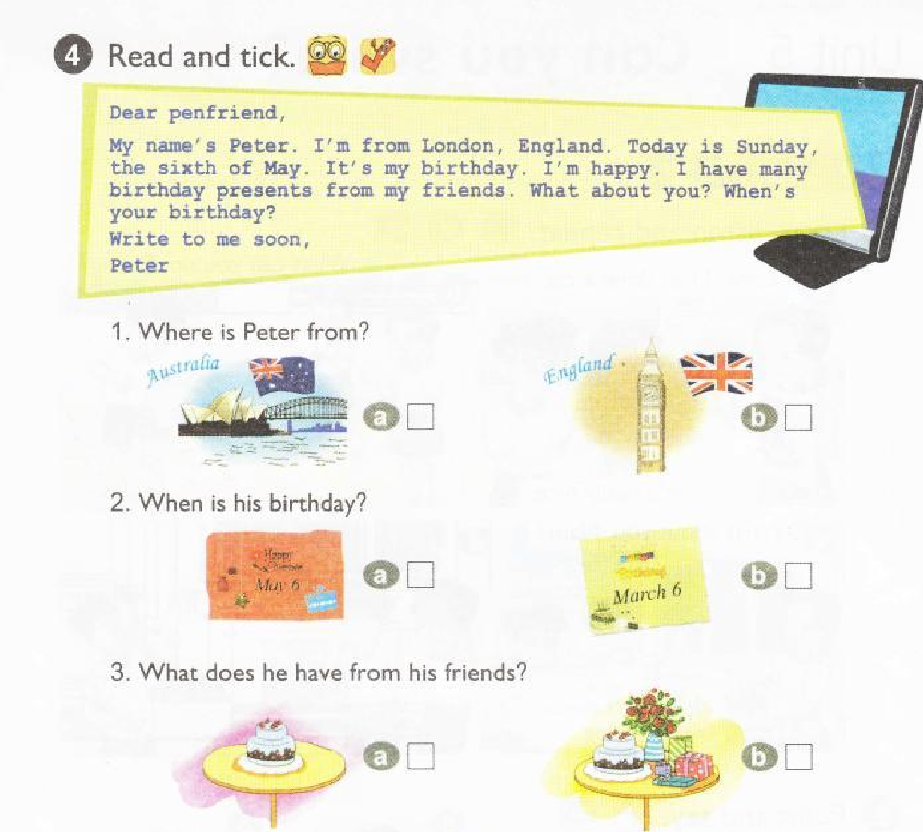



Slide 36
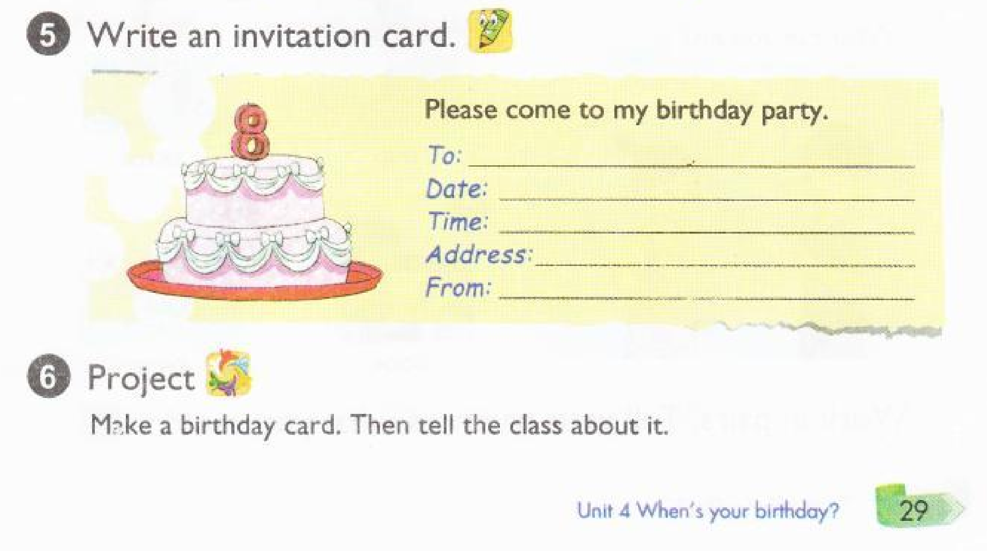
Le Quang Thang
4th June
19:00
232 Le Duan, Pleiku
Tran Le Gia Nguyen

Slide 37
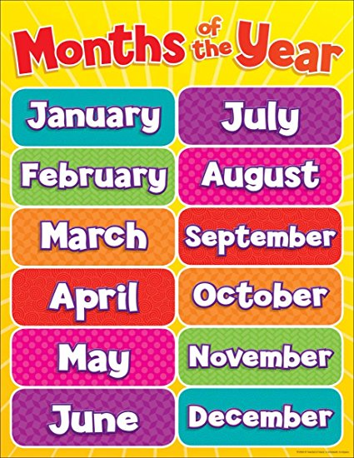
1.
7.
2.
8.
3.
9.
4.
10.
5.
11.
12.
6.

Slide 39
January: tháng 1
February: tháng 2
March: tháng 3
April: tháng 4
May: tháng 5
June: tháng 6
July: tháng 7
August: tháng 8
September: tháng 9
October: tháng 10
November: tháng 11
December: tháng 12
- When’s your birthday? Sinh nhật bạn là ngày nào?
- It’s on the second of March. Sinh nhật mình là ngày 2 tháng 3

Slide 40
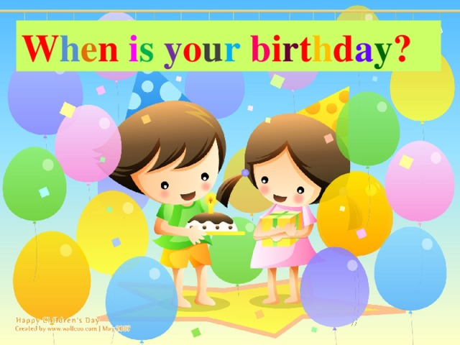
ASK AND ANSWER

Slide 41
Workbook

Slide 42
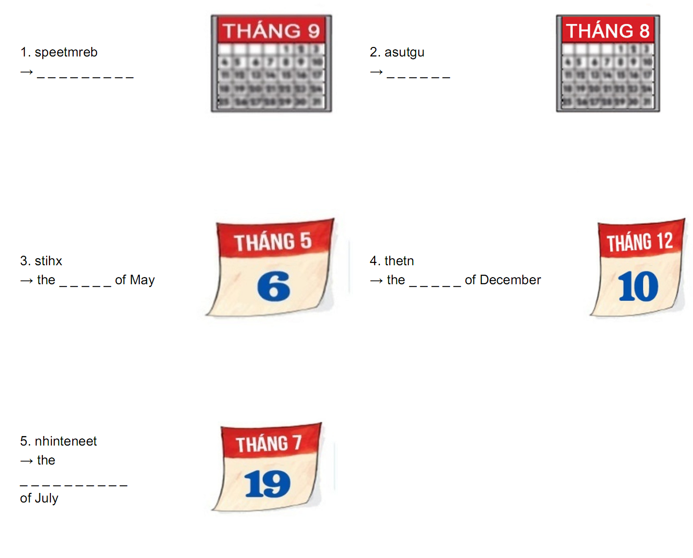

September
August
sixth
tenth
nineteenth

Slide 43

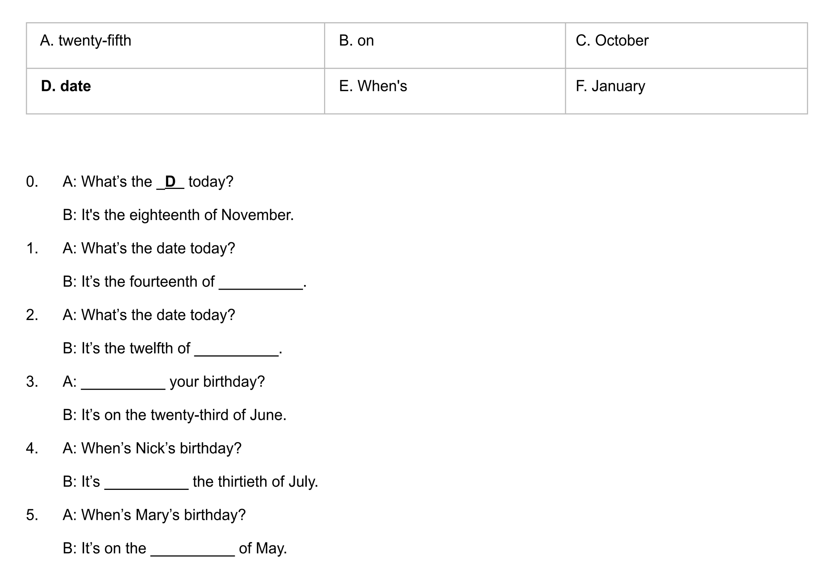

October
January
When’s
on
twenty-fifth

Slide 44
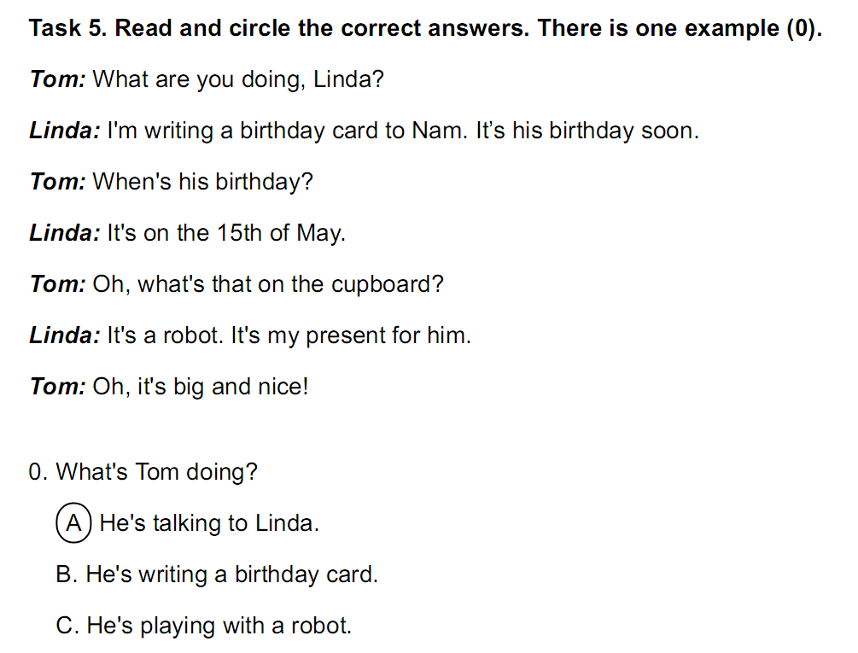

Slide 45
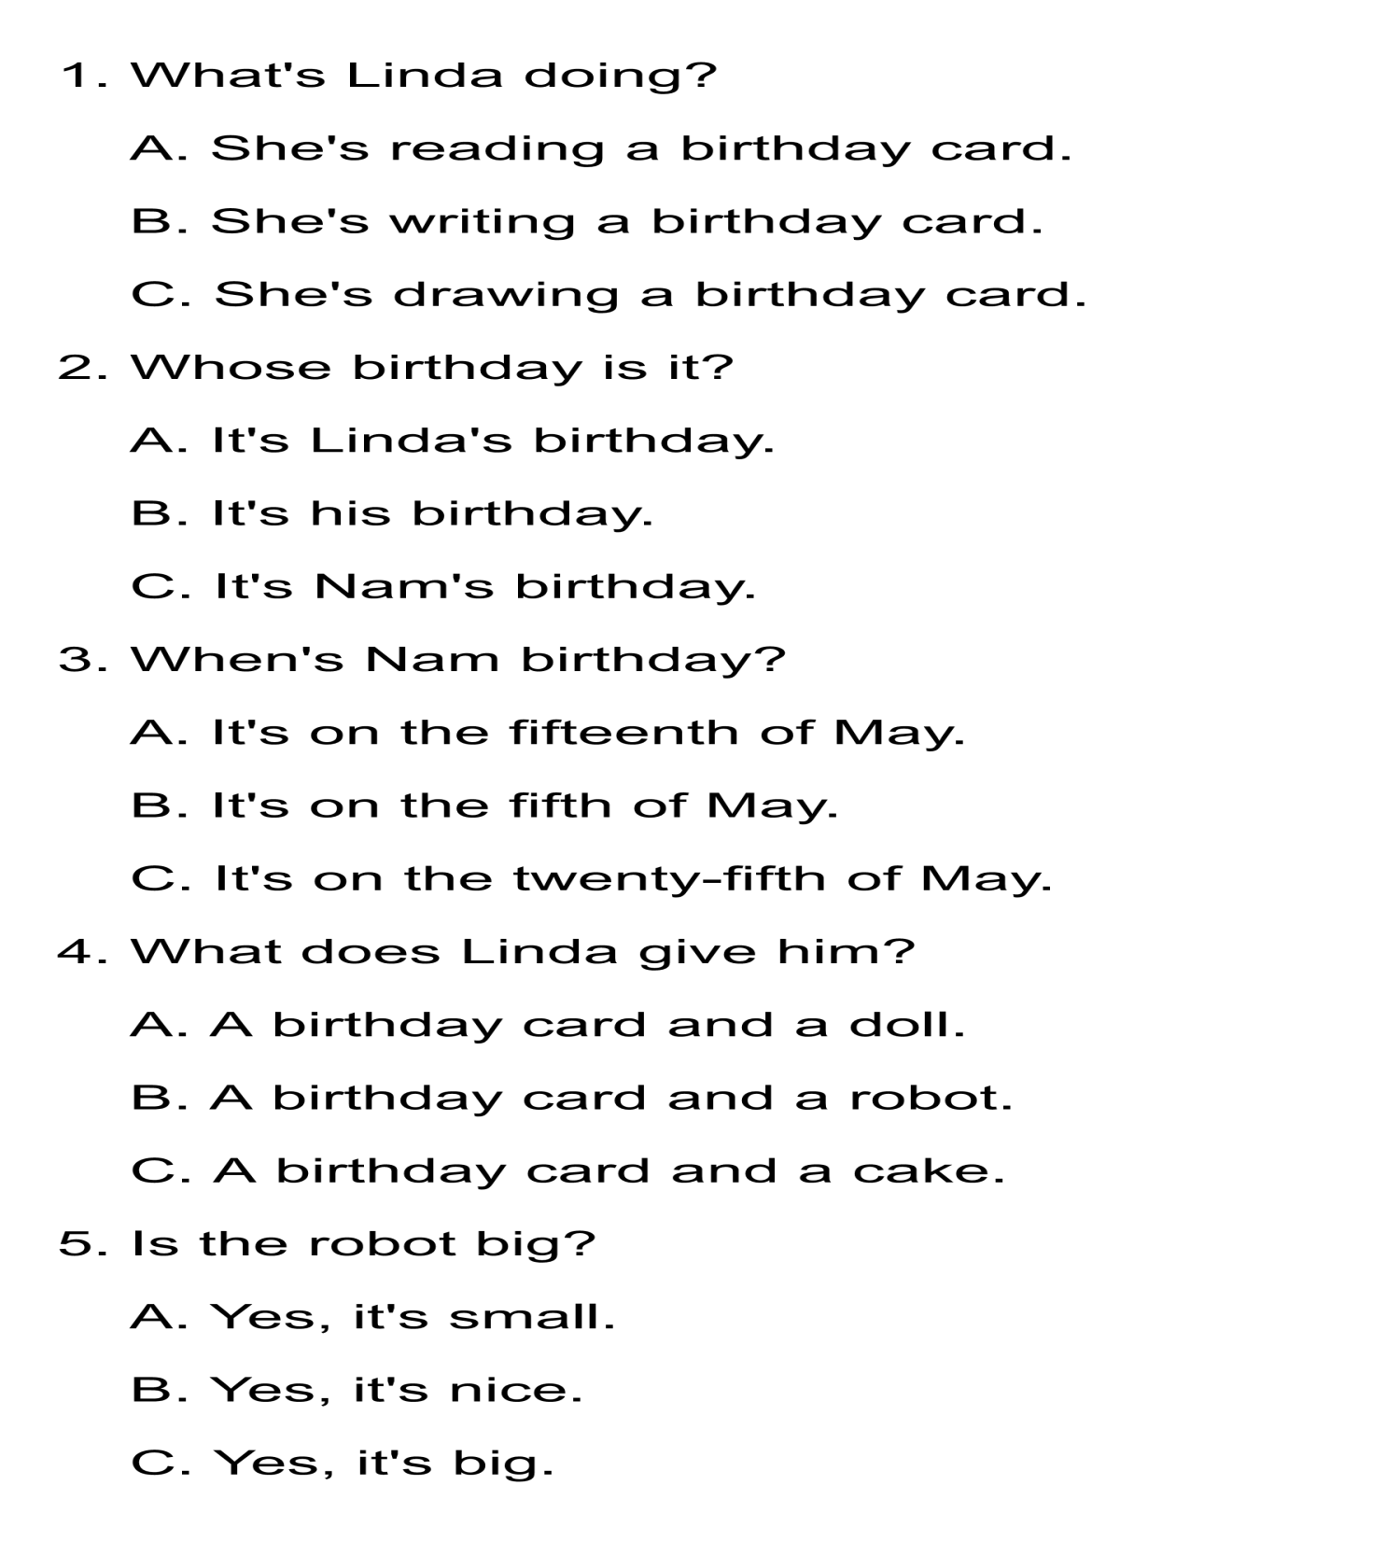

Slide 46

I. Match
December
March
1 2 3 4
October
May
August
July
5 6 7 8
January
September
9 10 11 12
April
February

